Slide 1
Storytelling with data
Dr. James Wisnowski – Adsurgo
Dr. Bradley Warner - USAFA

Slide 2
Outline
Intro
Where does Storytelling fit in the data viz ecosphere?
Data Collection
Data Visualization
Crafting a Story

Slide 3
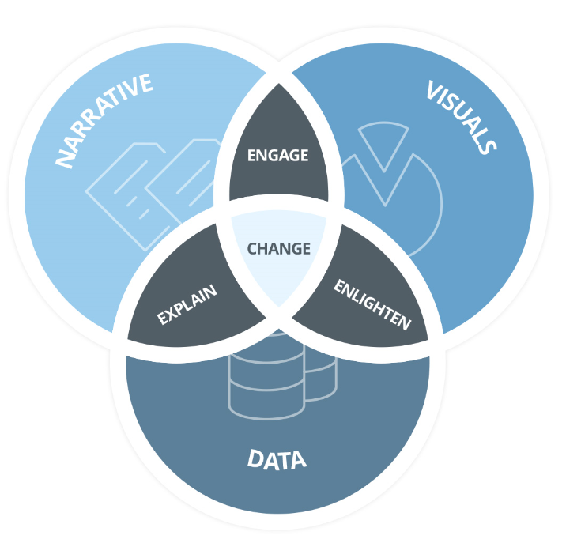
Introduction
Who are we
Research
Good Charts by Scott Berinato
Storytelling with Data by Cole Nussbaumer Knaflic
Data Points by Nathan Yau
Websites
Junkcharts
Flowing Data
TedTalk Storytelling
Engaging Your Audience
Best Ted Talk Hans Rosling

Slide 4
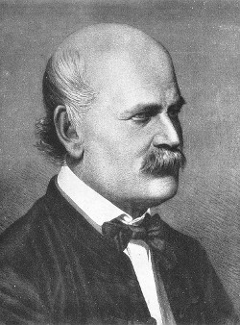
Dr Semmelweis

Slide 5
Data Sources “Data is the middleman between phenomenon and ideas about them”
Experiment
Observation
Resources
Data Search
US Government
Five Thirty Eight
Google Public Data

Slide 6
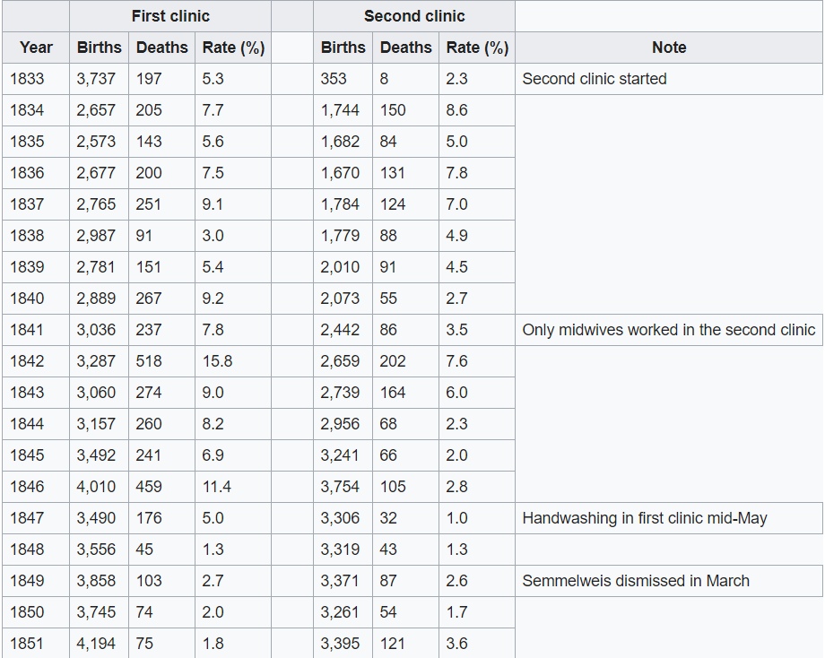
Semmelweis Data Wiki Page with Data

Slide 7
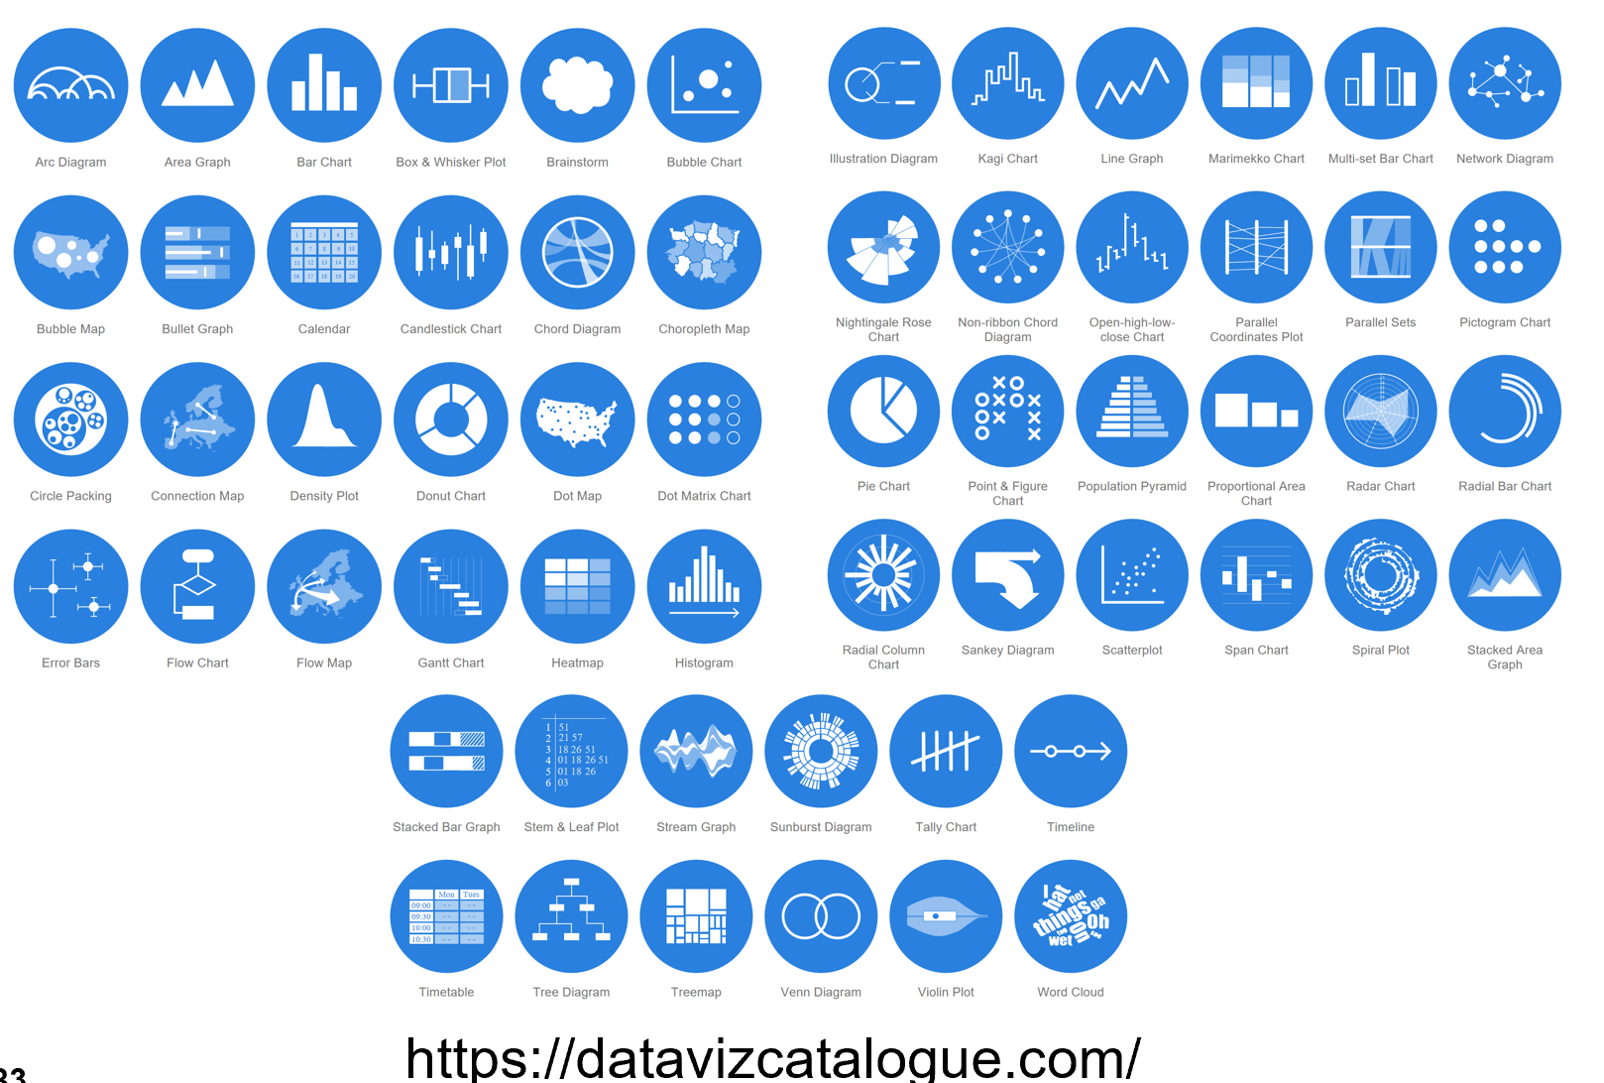
Data Viz Principles
We don’t go in order
We see first what stands out
We use our iconic memory first
We see only a few things at once
We seek meaning and make connections
We rely on conventions and metaphors
Interactive is better than static

Slide 8
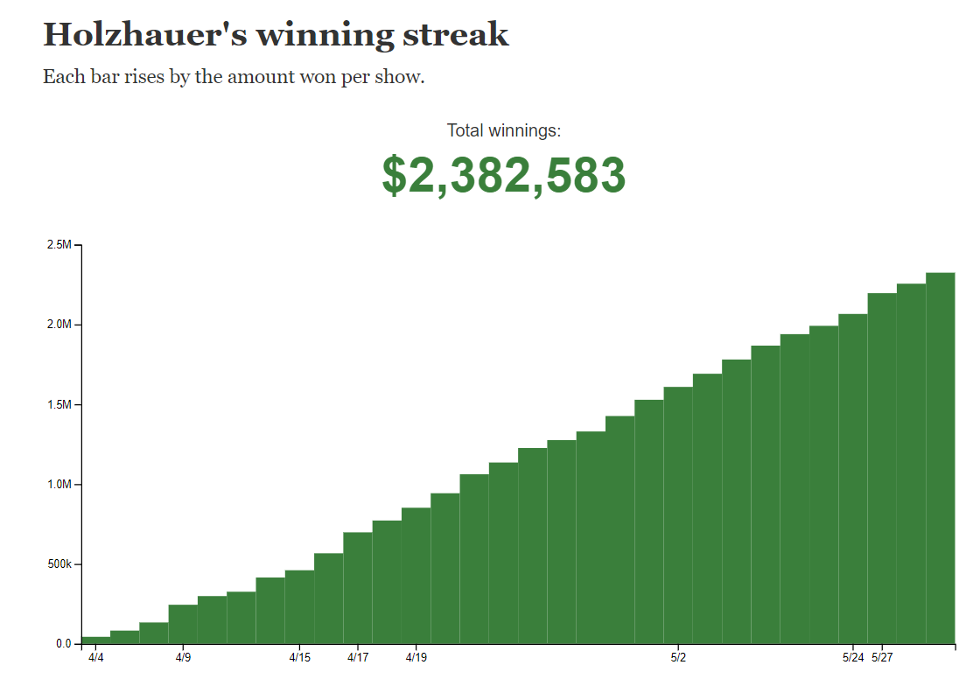
We don’t go in order
Read this chart and pay attention to what your eyes track.

Slide 9
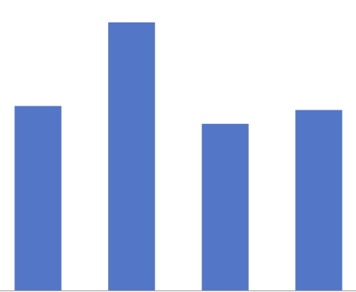





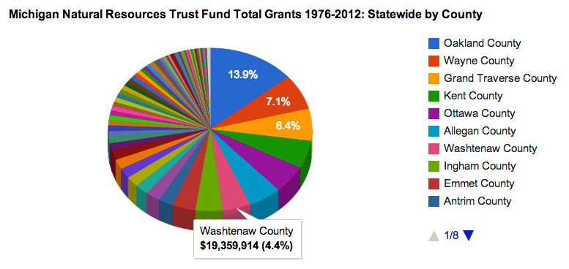


We use our iconic memory first
Shape
Hue/Contrast
Length
Does this pie graph appeal to our pre-attentive attributes?
Size
Position
Color
Enclosure
Symmetry
Grouping

Slide 10
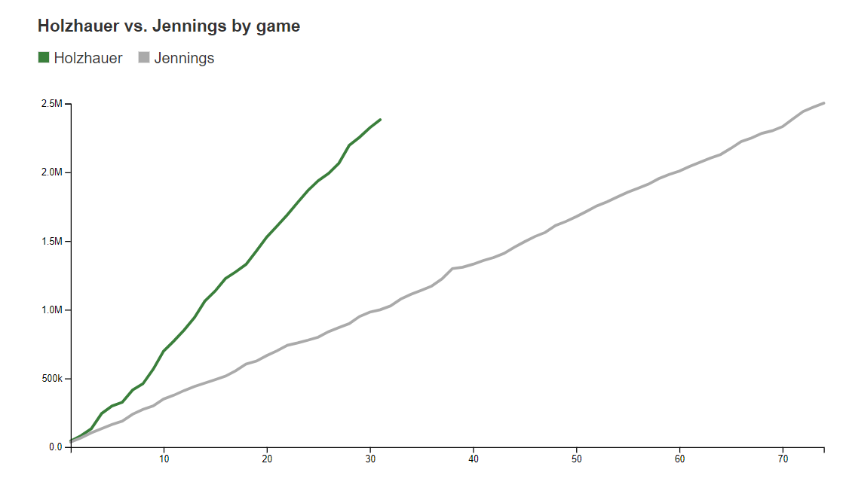
We see first what stands out
What did you notice first?

Slide 11
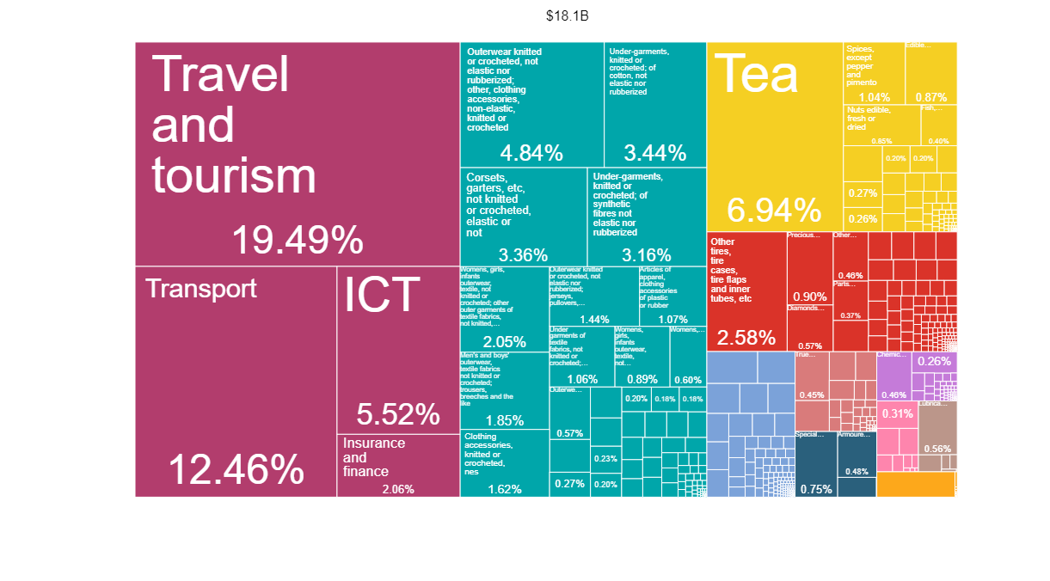
We only see a few things at once
What is your take-away from this graph?

Slide 12
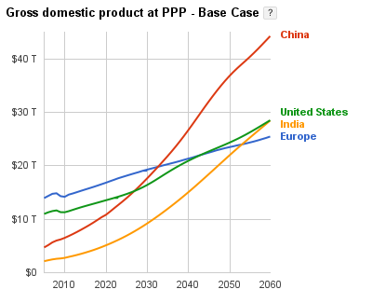
We seek meaning and make connections
What impression do you get from this?

Slide 13
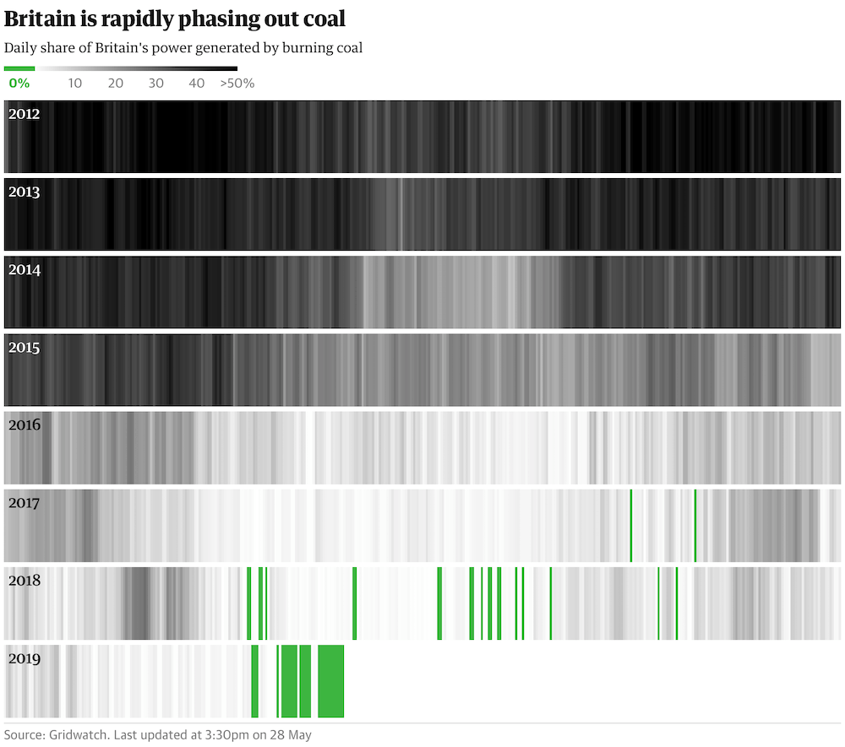
We rely on conventions and metaphors
Does this seem reversed?

Slide 14

Interactive Way of the Future
Interactivity is the way of the future
Collaboration
Live Question and Answer
Everything available/Not always visible
Examples
Google
Harvard
Gapminder

Slide 15
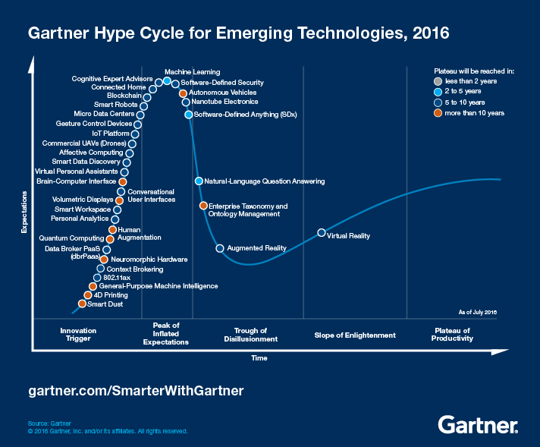
Chart typology
Declarative
Storytelling
Data: Simple
Type: Conventional
Features: Clear
Goals: Affirm
Idea illustration
Two Questions:
1. Is the information conceptual or data-driven?
2. Am I declaring something or exploring something?
Data-Driven
Conceptual
Idea generation
Visual exploration and discovery
Exploratory

Slide 16
Chart Creation
Who
Audience
Biases
What
What do you want them to know/do?
How will you communicate to audience?
How
What data will make the point?
Put aside:
Prep 10%: Who, What, and How
Talk and Listen 24%: Capture words, phrases, and statements
Sketch 33%: Work quickly, multiple approaches
Prototype 33%: Play with tools
Visual Vocabulary

Slide 17
Semmelweis Plot
Who
Audience
Biases
What
What do you want them to know/do?
How will you communicate to audience?
How
What data will make the point?

Slide 18
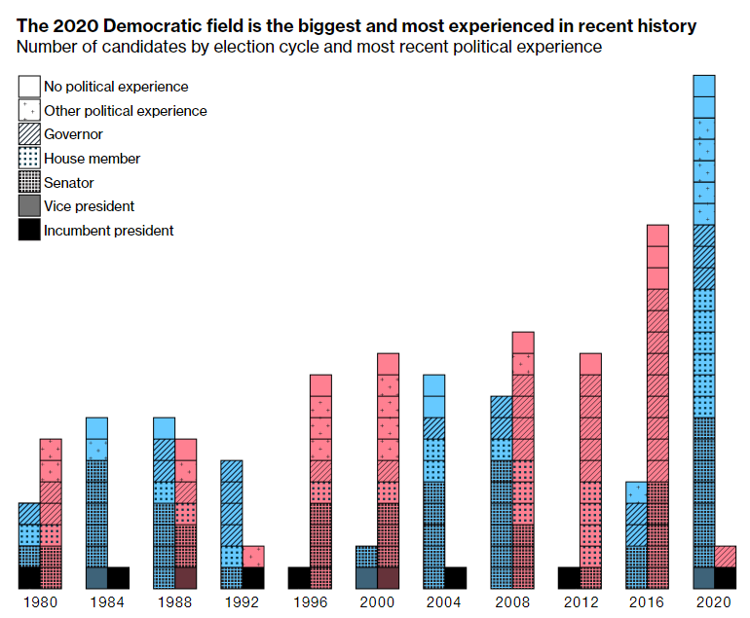
Chart Critique
Good writers are Great Readers
Note first things you see.
Note first idea that forms.
Note likes and dislikes.
Find three things you’d change and why.
Sketch your own version.

Slide 19
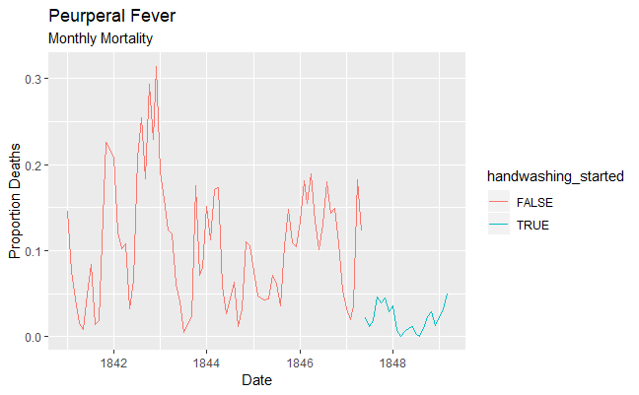
Chart Critique Semmelweis
Note first things you see.
Note first idea that forms.
Note likes and dislikes.
Find three things you’d change and why.
Sketch your own version.

Slide 20
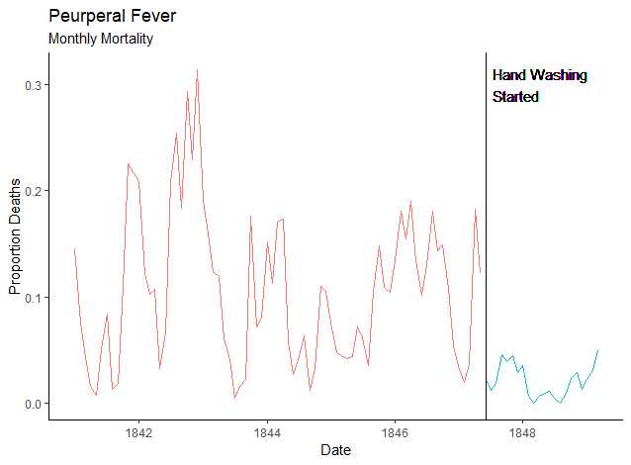
Improved Plot
Maximize data to ink ratio
Align
Reduce clutter
Remove border
Remove background
Don’t fear white space
Strategic use of contrast
Focus attention

Slide 21
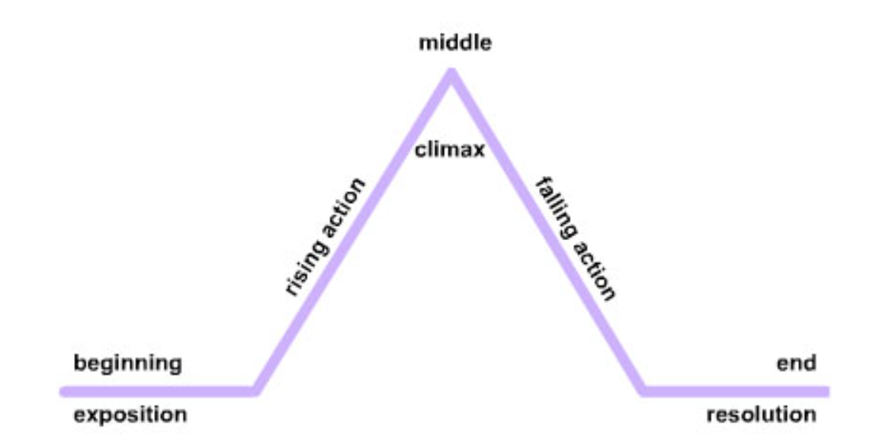
Storytelling Principles
3-Minute Story
Big Idea
3 Acts
Beginning – Sets up the story
Middle – The bulk of the story, main characters attempts to resolve the problem
End – climax where the tension is resolved and the question is answered.
Conflict and Tension are necessary
ABCDEFG. HIJ
Use Pauses: Don’t Annoy
Use when there is something to reveal
Notes:
The 3‐minute story is exactly that: if you had only three minutes to tell your audience what they need to know, what would you say?
The Big Idea boils the so‐what down even further: to a single sentence.
This is a concept that Nancy Duarte discusses in her book,
Resonate (2010). She says the Big Idea has three components:
1. It must articulate your unique point of view;
2. It must convey what’s at stake; and
3. It must be a complete sentence.

Slide 22
Storytelling Principles
Importance of context
Audience analysis
Goal of your research and defining problem effectively
Effective visualizations
Appropriate use of common graphs
What not to do
Clutter is your enemy
Brainpower is a limited resource
Gestalt Principles and importance of whitespace

Slide 23
Storytelling Principles
Focus your audience’s attention
Understand pre-attentive attributes as visual hierarchy
Importance of color
Think like a designer
Form (the visual) follows function (purpose)
How to gain audience acceptance
Dissect model visuals
Principles of excellence
Effective use of thickness, order, and size

Slide 24
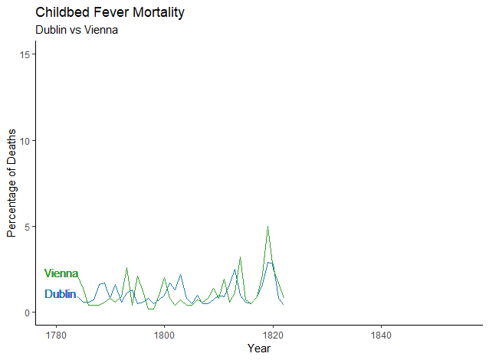

Slide 25
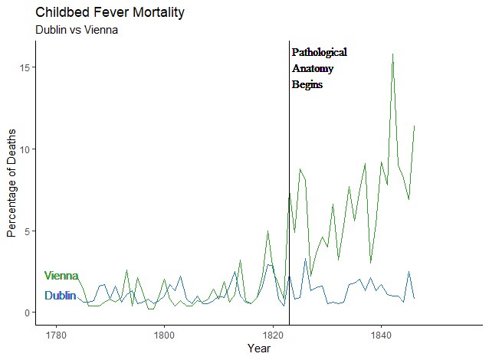

Slide 26
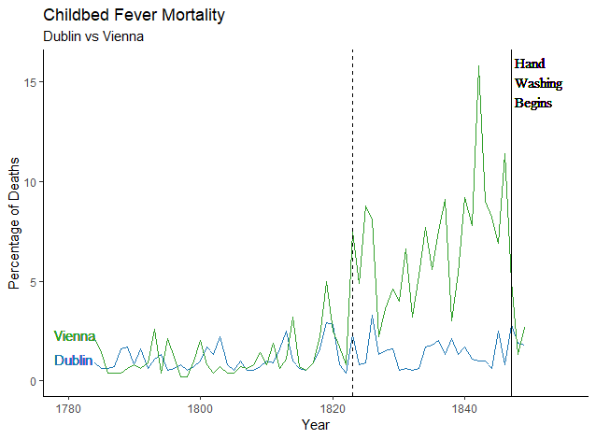

Slide 27
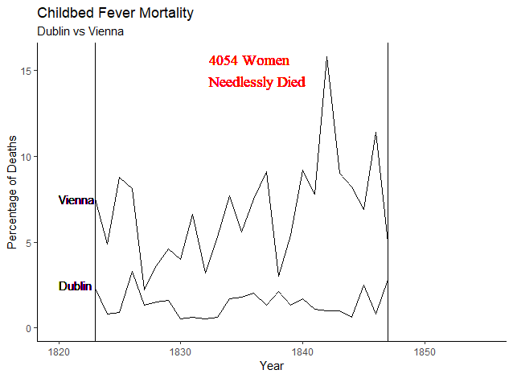
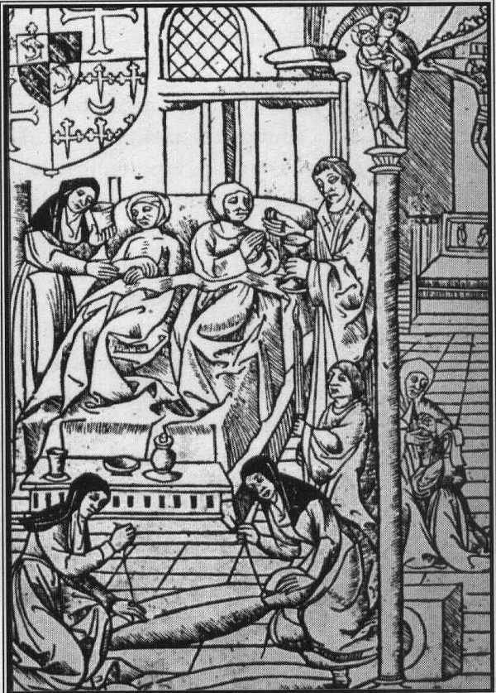

Slide 28

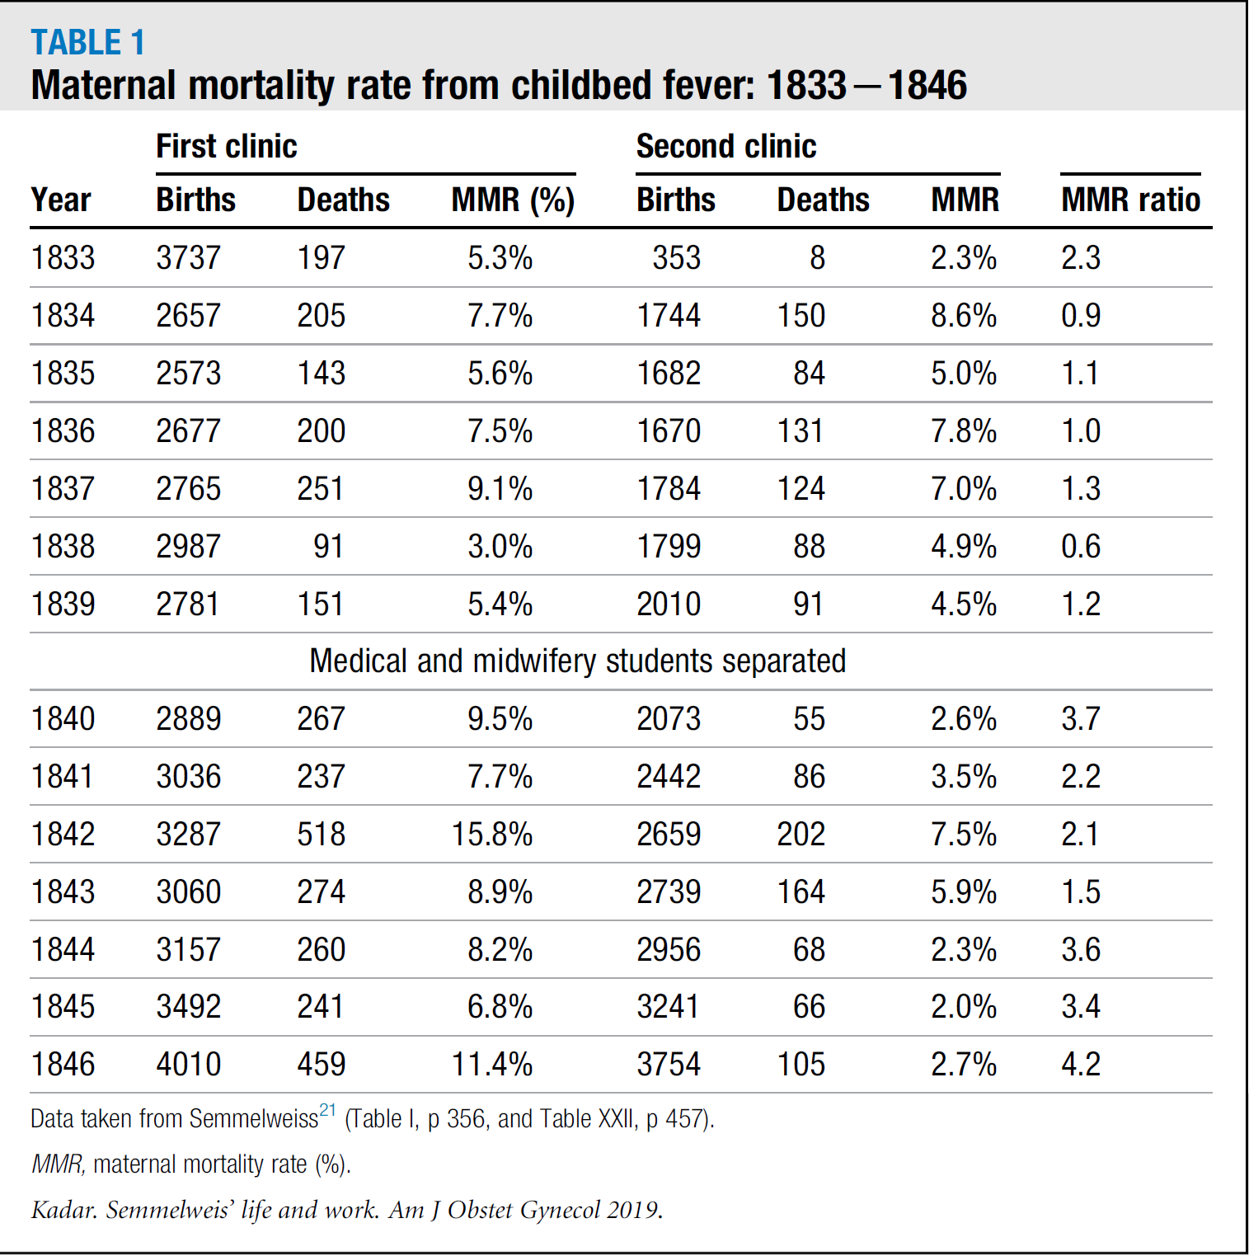
Semmelweis Visualization in the Literature

Slide 29
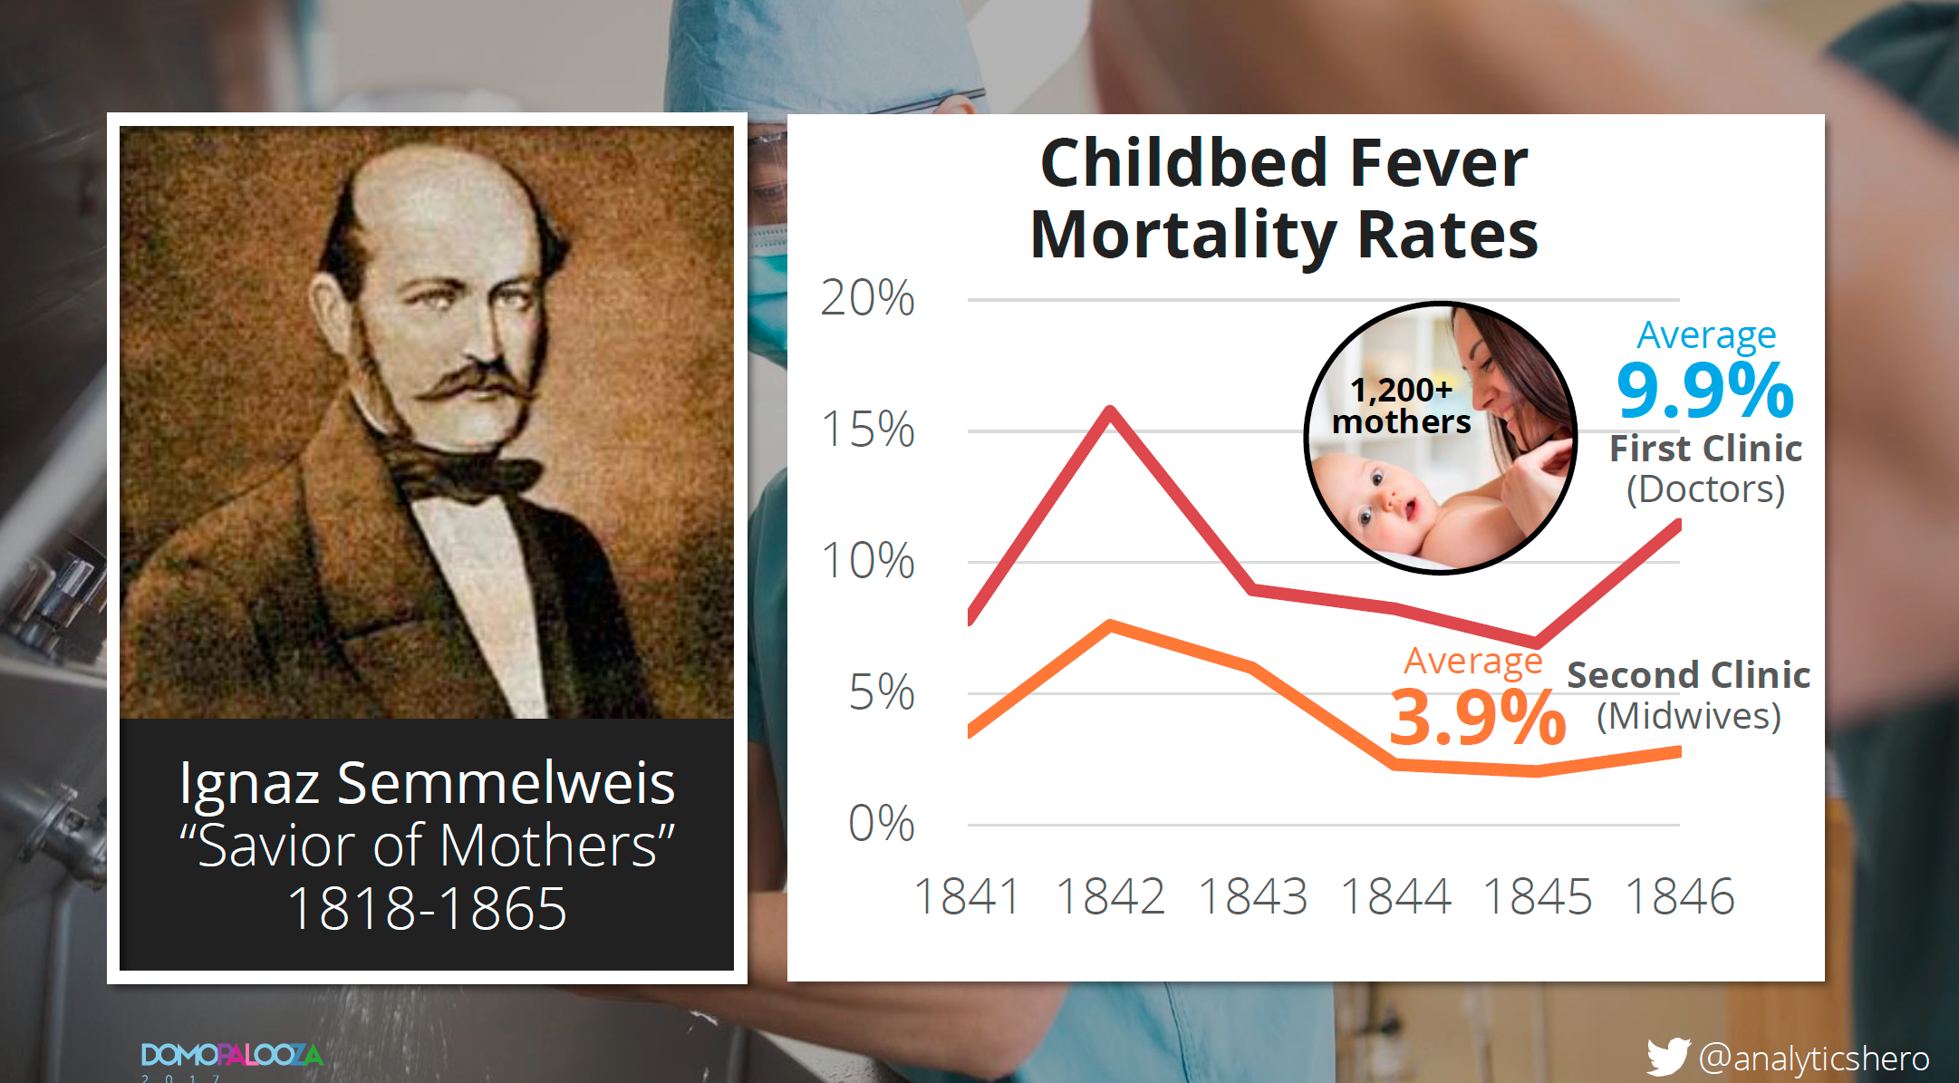
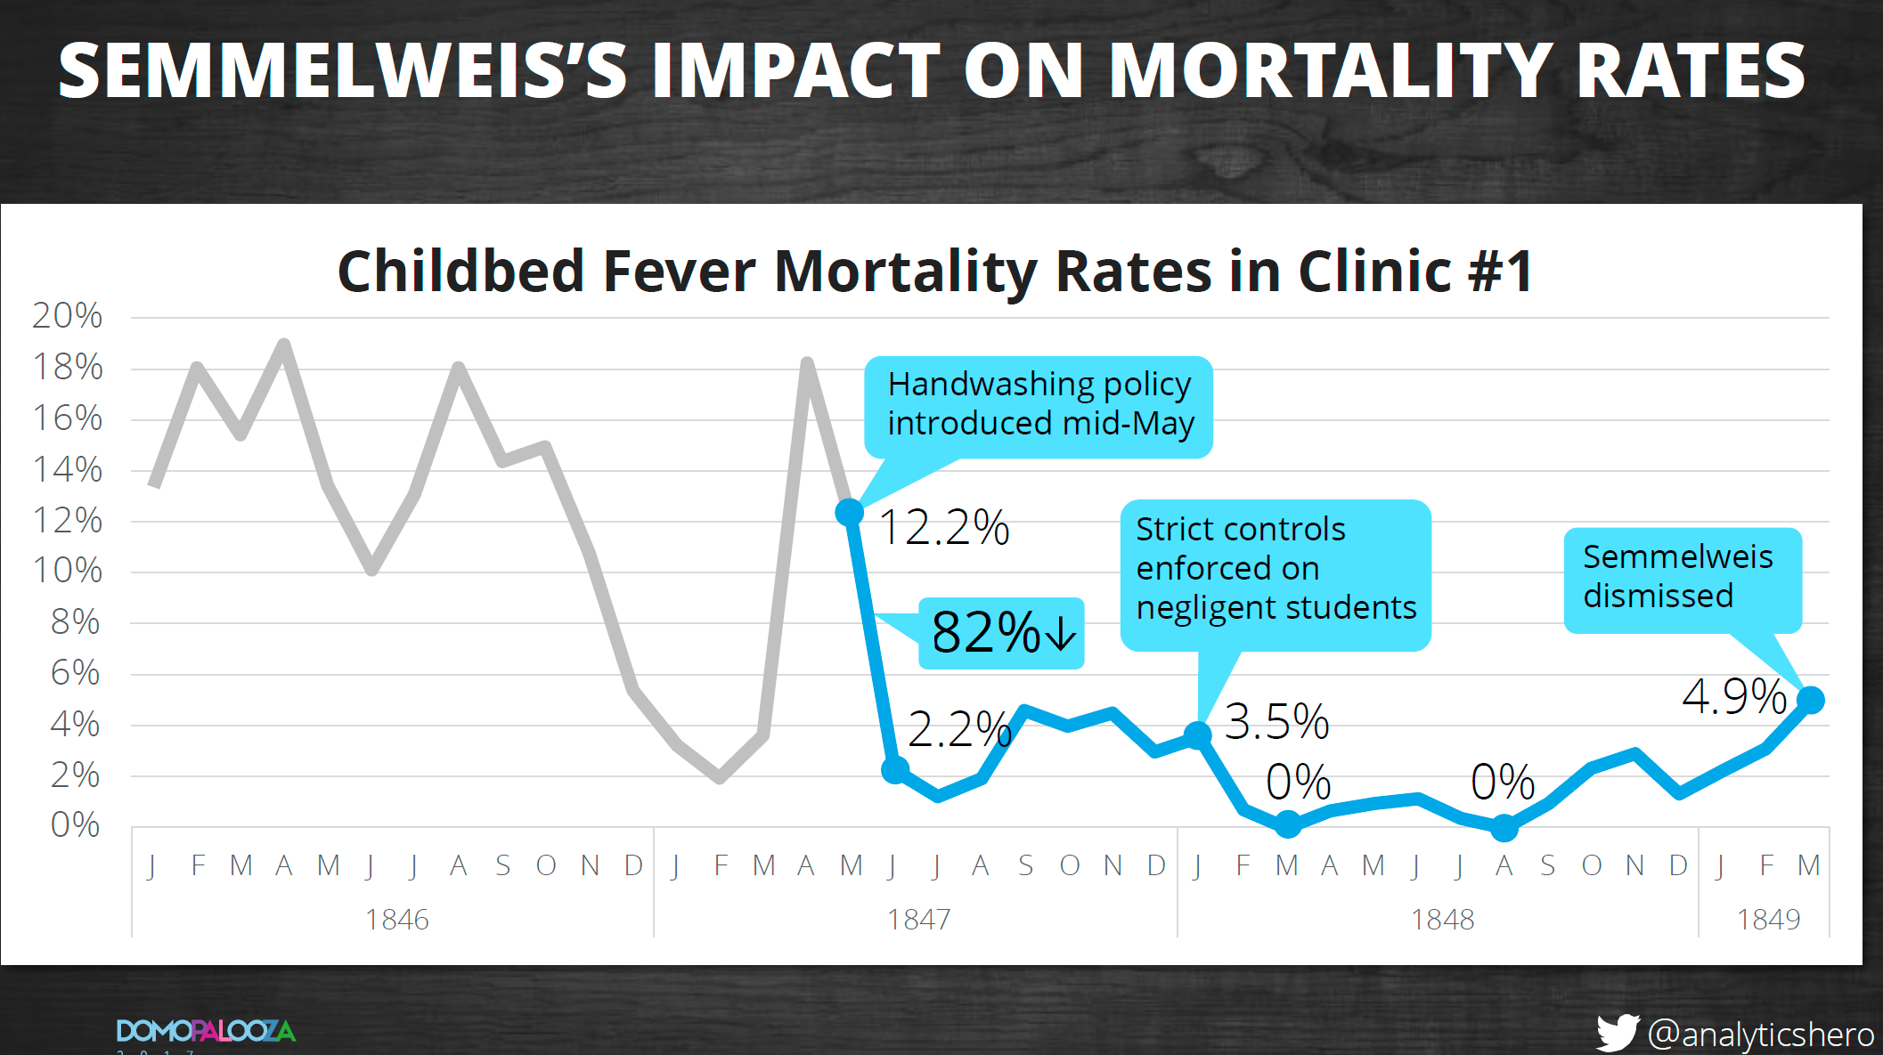
Chart Critique Semmelweis
Source: Brent Dykes, Domopalooza 2017
https://knowledge.domo.com/Training/Domopalooza_Resources/Domopalooza_2017/Stories_Rule_the_World%3A_How_to_Tell_a_Better_Story_with_Data

Slide 30
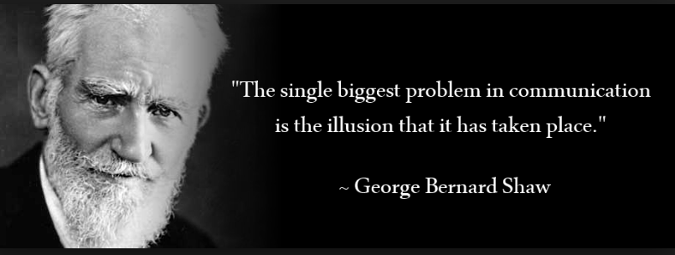
Questions? Thank You!
Questions
Thank you and have a great symposium!

